Slide 1
Application I: Efficient SAR Imaging for Non-Cooperative Scanning Geometries
Josiah Smith

Slide 2
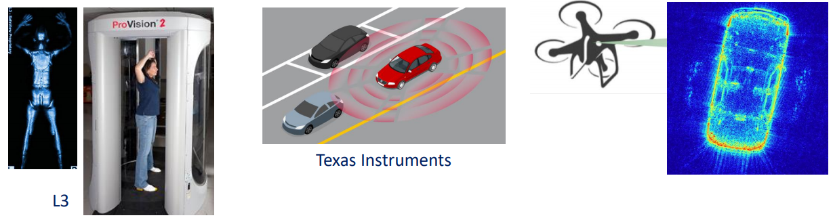
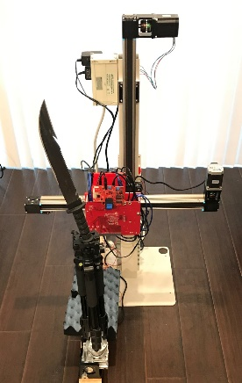
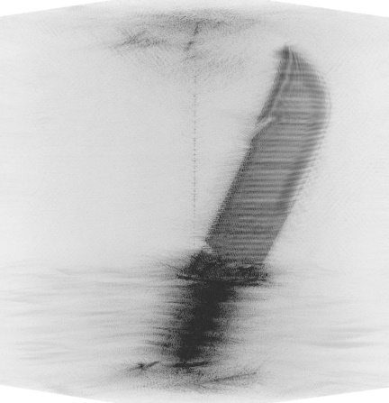
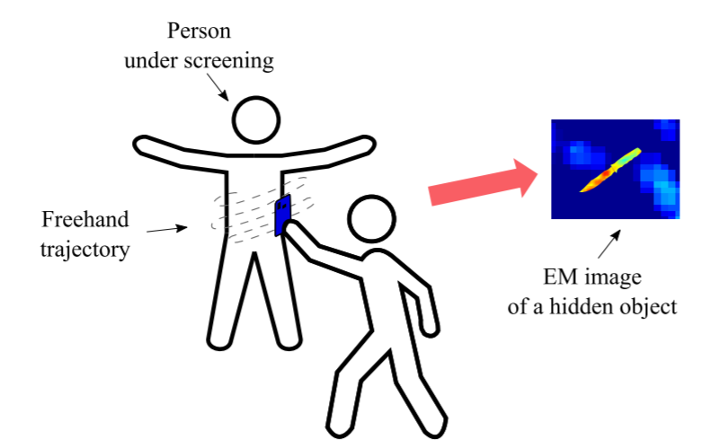

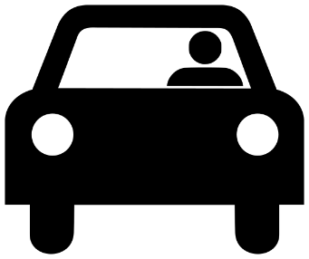

Motivation – Non-Cooperative Array Imaging
Traditional array imaging techniques require highly controlled positioning for SAR scanning apparatus
Emerging applications require relaxing this constraint
Smart phone mmWave scanner: mobile threat detection
ISSUE: limited computation power on cell phone
Automotive SAR imaging
Challenge:
Efficient image reconstruction algorithms rely on simple scanning patterns
Non-cooperative scanning patterns are typically considered infeasible due to computational expense
Traditional Array Imaging: Controlled Scanning Pattern

Slide 3







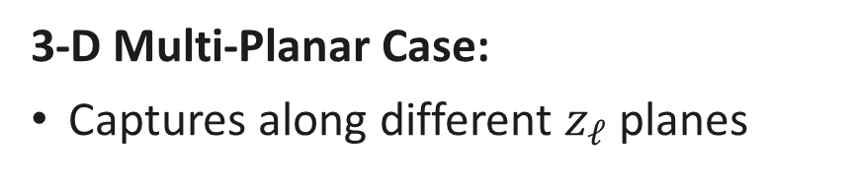

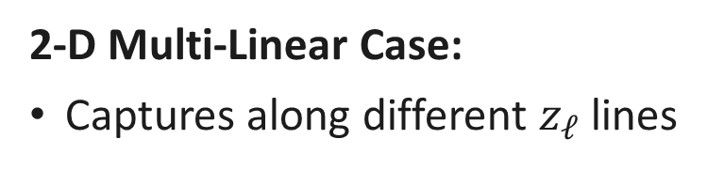



Multi-Planar Array Concept
2-D Multi-Linear Case:
Captures along different $z_{ℓ}$ lines
3-D Multi-Planar Case:
Captures along different $z_{ℓ}$ planes
$$y$$
$$y$$
Tx
Tx
Rx
Rx
$$x$$
$$R_{ℓ}^{R}$$
Target
$$R_{ℓ}^{R}$$
$$R_{ℓ}^{T}$$
$$R_{ℓ}^{T}$$
Target
$$z_{ℓ}$$
$$z$$
$$z$$
$$z_{ℓ}$$

Slide 4




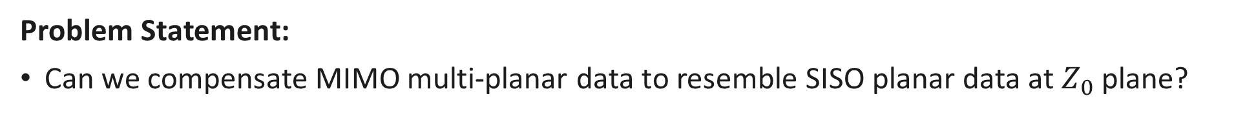



Multi-Planar Array Compensation
Problem Statement:
Can we compensate MIMO multi-planar data to resemble SISO planar data at $Z_{0}$ plane?
$$y$$
Tx
Rx
$$x$$
$$R_{ℓ}^{R}$$
$$R_{0}$$
$$R_{ℓ}^{T}$$
Target
$$Z_{0}$$
$$z$$

Slide 5
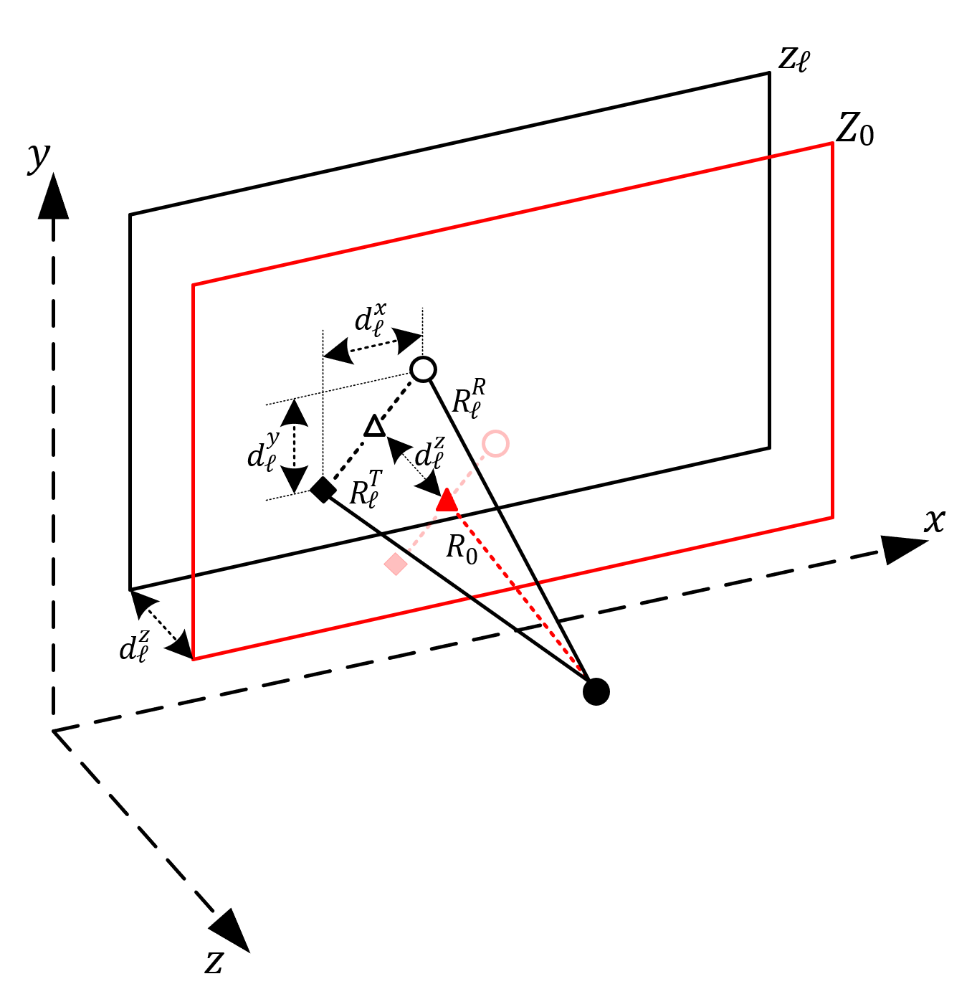

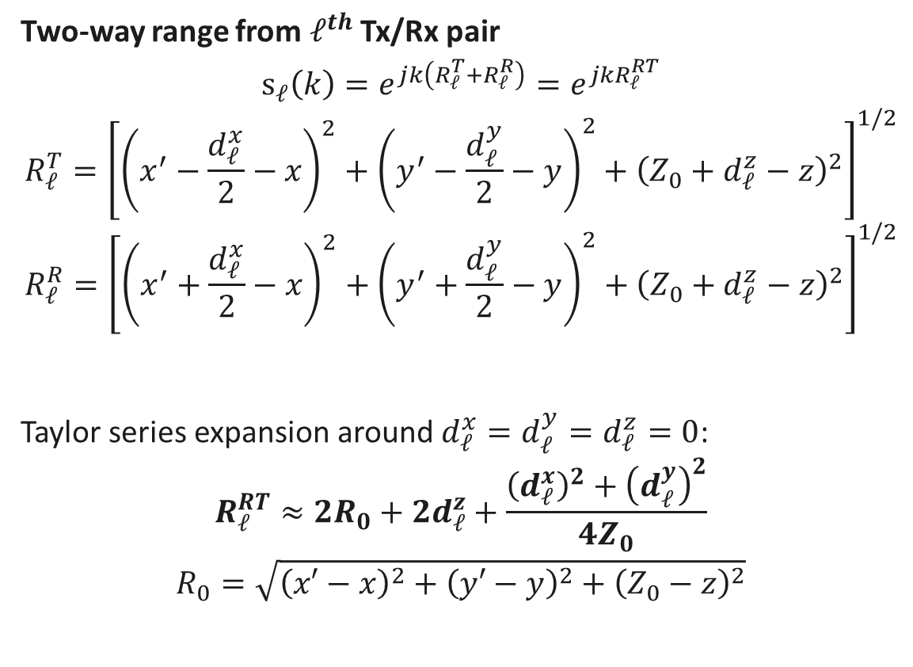
Signal Model
Two-way range from $ℓ^{th}$ Tx/Rx pair
$$s_{ℓ}\left(k\right)=e^{jk\left(R_{ℓ}^{T}+R_{ℓ}^{R}\right)}=e^{jkR_{ℓ}^{RT}}$$
$$R_{ℓ}^{T}={\left[{\left(x^{′}−\frac{d_{ℓ}^{x}}{2}−x\right)}^{2}+{\left(y^{′}−\frac{d_{ℓ}^{y}}{2}−y\right)}^{2}+{\left(Z_{0}+d_{ℓ}^{z}−z\right)}^{2}\right]}^{1/2}$$
$$R_{ℓ}^{R}={\left[{\left(x^{′}+\frac{d_{ℓ}^{x}}{2}−x\right)}^{2}+{\left(y^{′}+\frac{d_{ℓ}^{y}}{2}−y\right)}^{2}+{\left(Z_{0}+d_{ℓ}^{z}−z\right)}^{2}\right]}^{1/2}$$
Taylor series expansion around $d_{ℓ}^{x}=d_{ℓ}^{y}=d_{ℓ}^{z}=0$:
$$R_{ℓ}^{RT}≈2R_{0}+{2d}_{ℓ}^{z}+\frac{{\left(d_{ℓ}^{x}\right)}^{2}+{\left(d_{ℓ}^{y}\right)}^{2}}{4Z_{0}}$$
$$R_{0}=\sqrt{{\left(x′−x\right)}^{2}+{\left(y′−y\right)}^{2}+{\left(Z_{0}−z\right)}^{2}}$$
Tx
Rx
$$z_{ℓ}=Z_{0}+d_{ℓ}^{z}$$

Slide 6
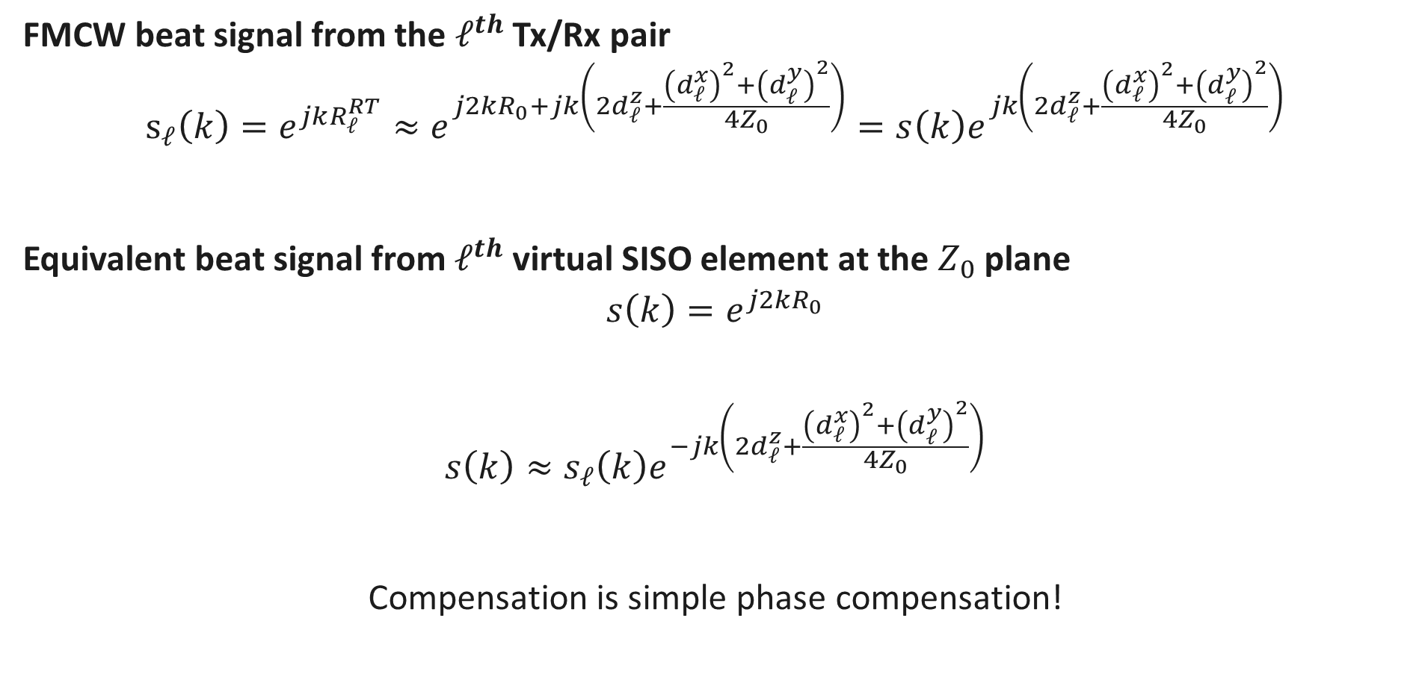
Signal Model (cont.)
FMCW beat signal from the $ℓ^{th}$ Tx/Rx pair
$$s_{ℓ}\left(k\right)=e^{jkR_{ℓ}^{RT}}≈e^{j2kR_{0}+jk\left(2d_{ℓ}^{z}+\frac{{\left(d_{ℓ}^{x}\right)}^{2}+{\left(d_{ℓ}^{y}\right)}^{2}}{4Z_{0}}\right)}=s\left(k\right)e^{jk\left(2d_{ℓ}^{z}+\frac{{\left(d_{ℓ}^{x}\right)}^{2}+{\left(d_{ℓ}^{y}\right)}^{2}}{4Z_{0}}\right)}$$
Equivalent beat signal from $ℓ^{th}$ virtual SISO element at the $Z_{0}$ plane
$$s\left(k\right)=e^{j2kR_{0}}$$
$$s\left(k\right)≈s_{ℓ}\left(k\right)e^{−jk\left(2d_{ℓ}^{z}+\frac{{\left(d_{ℓ}^{x}\right)}^{2}+{\left(d_{ℓ}^{y}\right)}^{2}}{4Z_{0}}\right)}$$
Compensation is simple phase compensation!

Slide 7
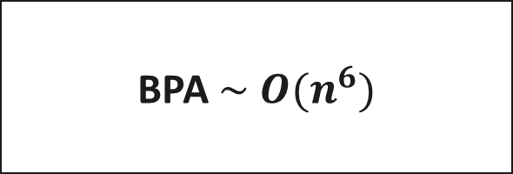

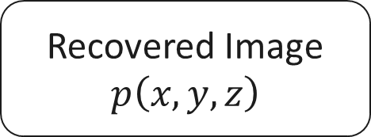

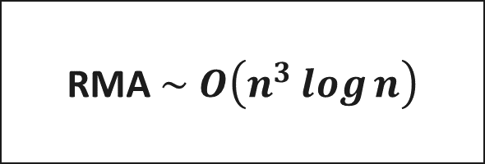
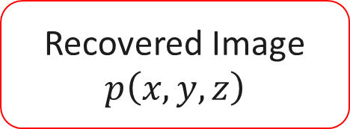

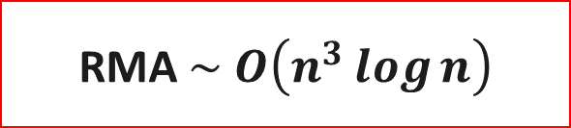

Algorithm Comparison
$$s_{ℓ}\left(k\right)$$
$$s_{ℓ}\left(k\right)$$
$$s_{ℓ}\left(k\right)$$
Phase Compensation
BPA $\sim O(n^{6})$
RMA $\sim O\left(n^{3}\log{n}\right)$
RMA $\sim O\left(n^{3}\log{n}\right)$
Recovered Image
$$p\left(x,y,z\right)$$
Recovered Image
$$p\left(x,y,z\right)$$
Recovered Image
$$p\left(x,y,z\right)$$

Slide 8
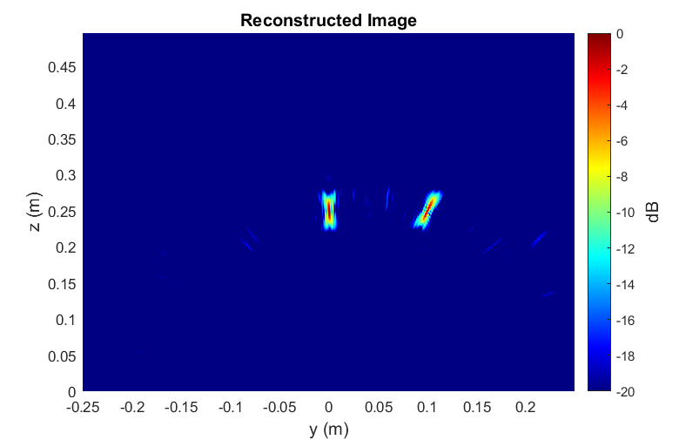
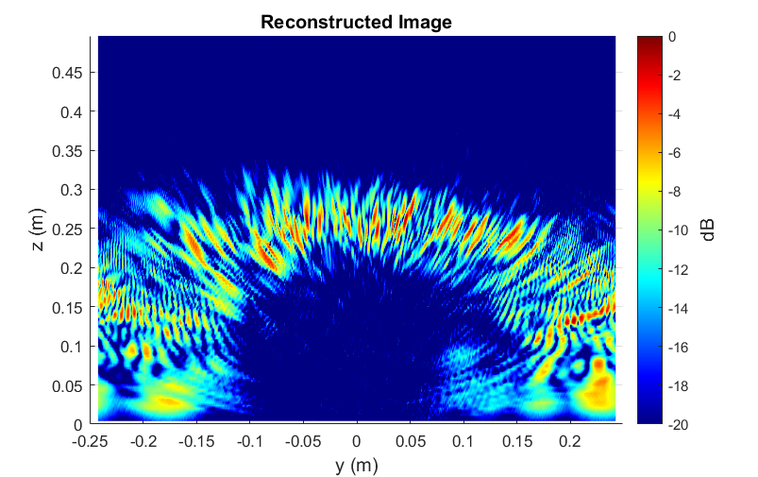
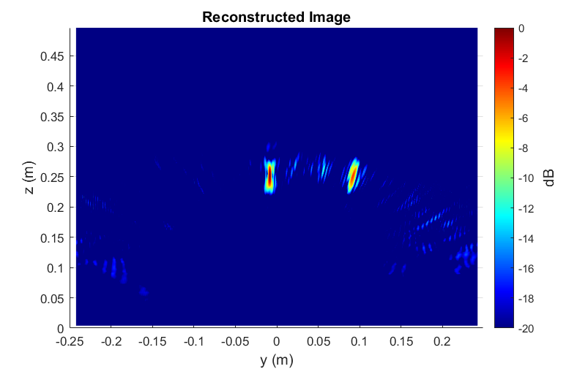
Simulation Results
Multi-Linear Array – Point Targets
Antenna perturbance: Gaussian
BPA – 5 mins
RMA – 30 ms
Ours – 30 ms

Slide 9
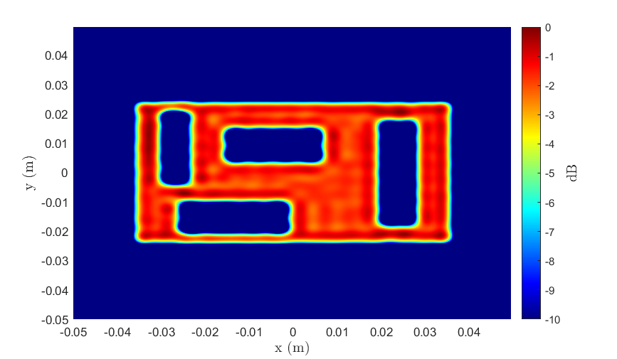
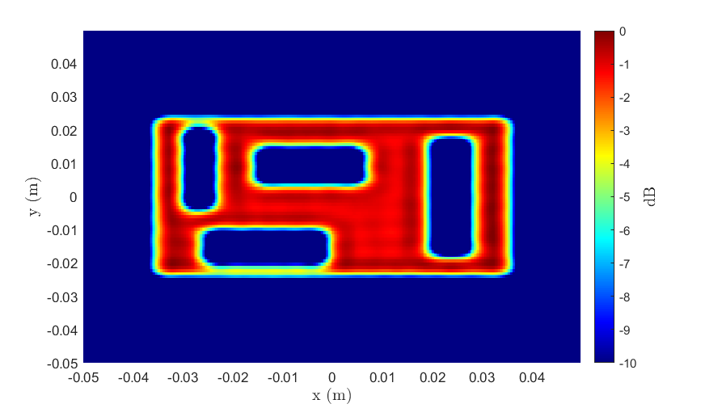
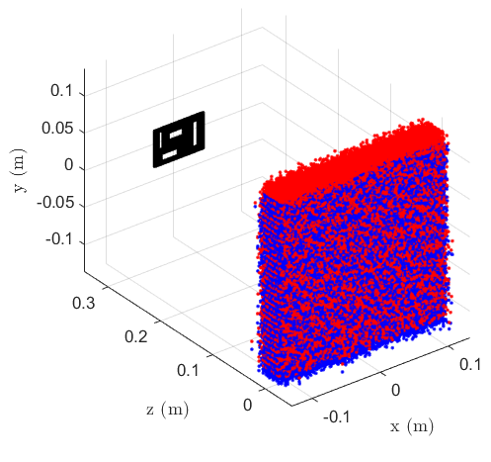
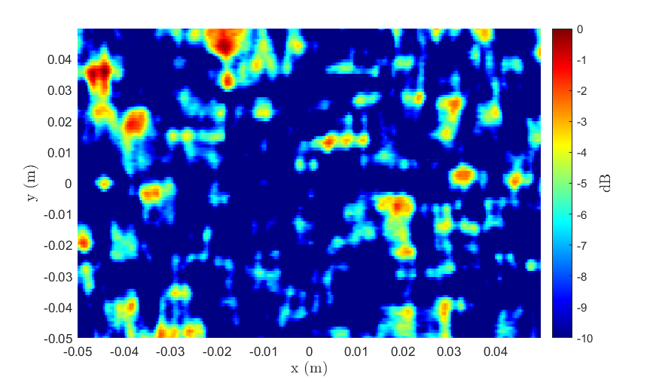
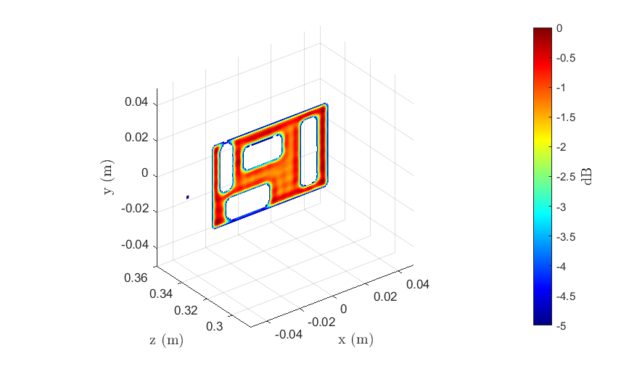
Simulation Results
Multi-Planar Array – Cutout
2-D BPA – 3 hrs
3-D BPA – 150 hrs
Ours – 1 s
RMA – 1 s
Ours – 14 s

Slide 10
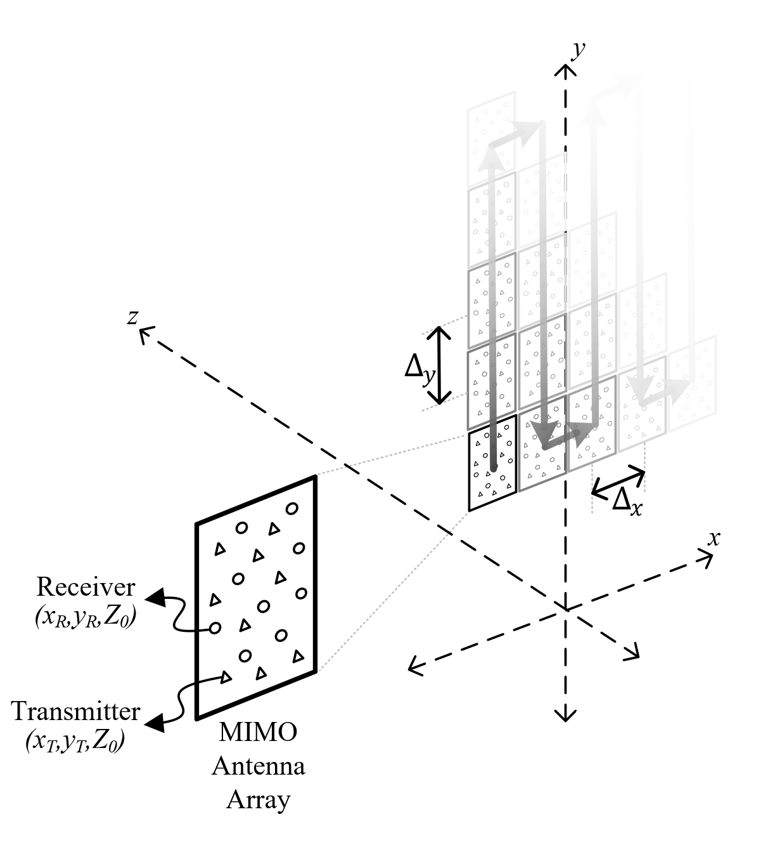

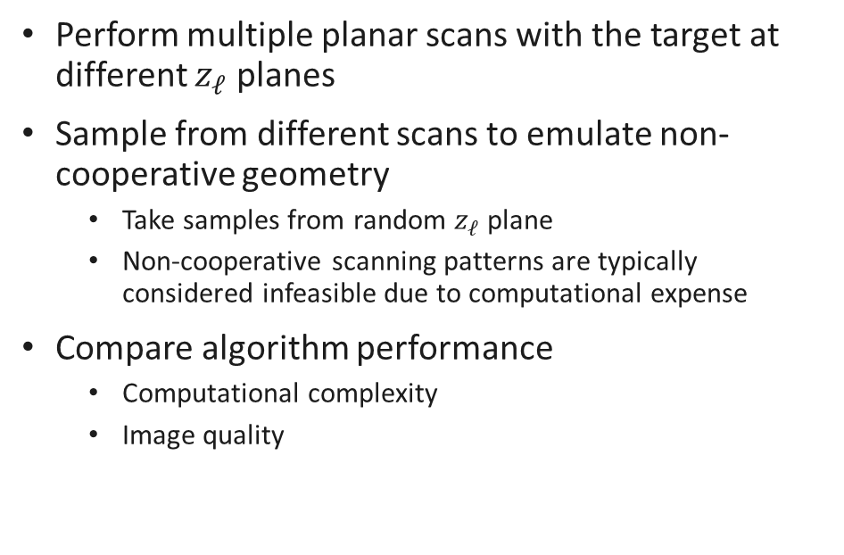
System Design
Multi-Planar Array – Emulate Non-cooperative Geometry
Perform multiple planar scans with the target at different $z_{ℓ}$ planes
Sample from different scans to emulate non-cooperative geometry
Take samples from random $z_{ℓ}$ plane
Non-cooperative scanning patterns are typically considered infeasible due to computational expense
Compare algorithm performance
Computational complexity
Image quality

Slide 11
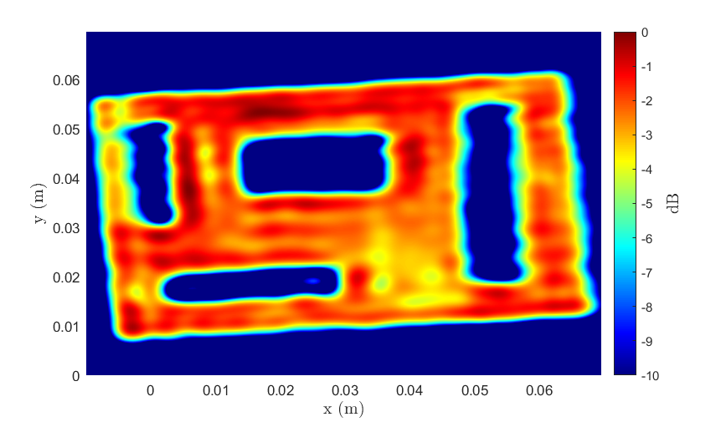
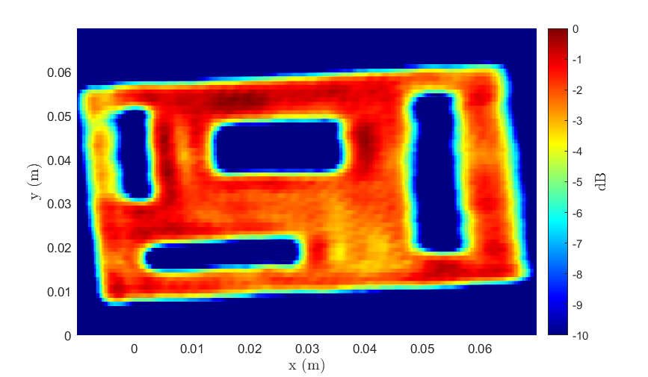
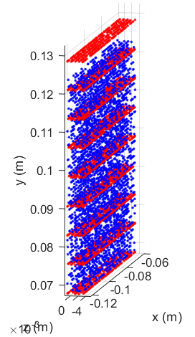
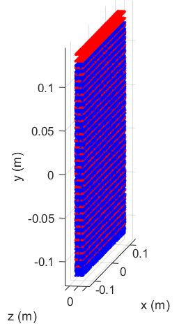
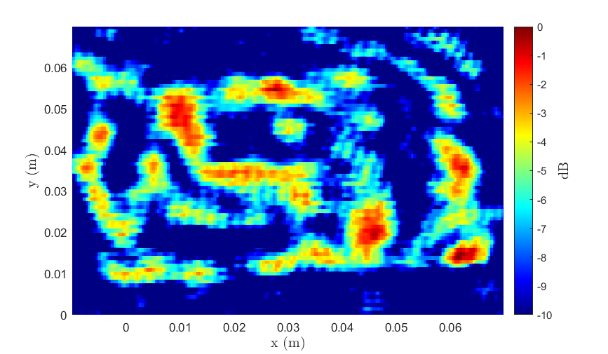
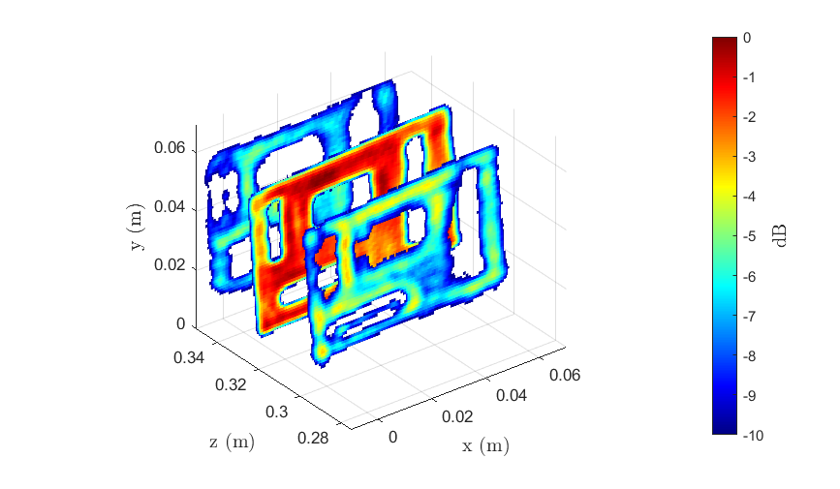
Real Results
Multi-Planar Array – Cutout
Antenna perturbance: Uniform Random
2-D BPA – 3 hrs
3-D BPA – 150 hrs
Ours – 1 s
RMA – 1 s
Ours – 14 s

Slide 12
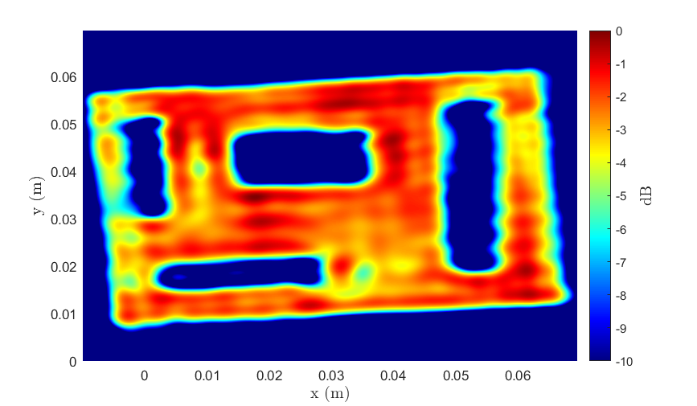
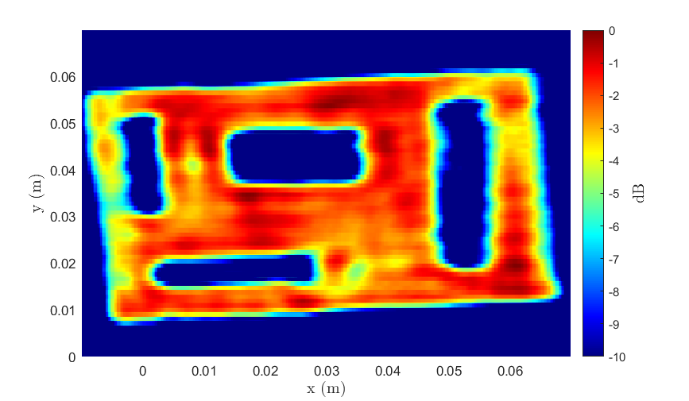
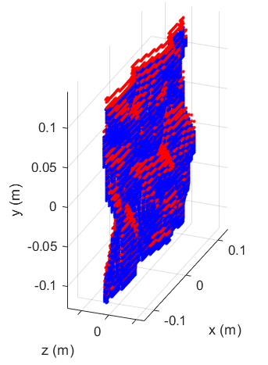
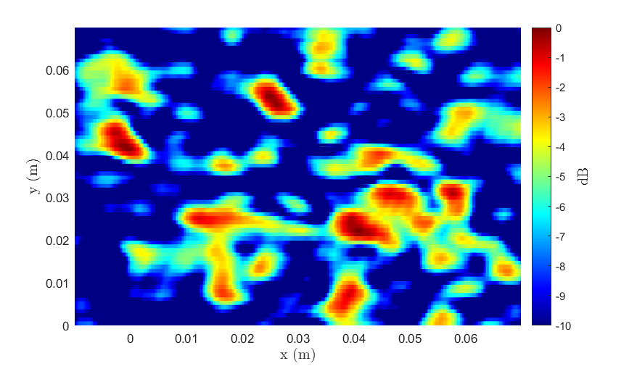
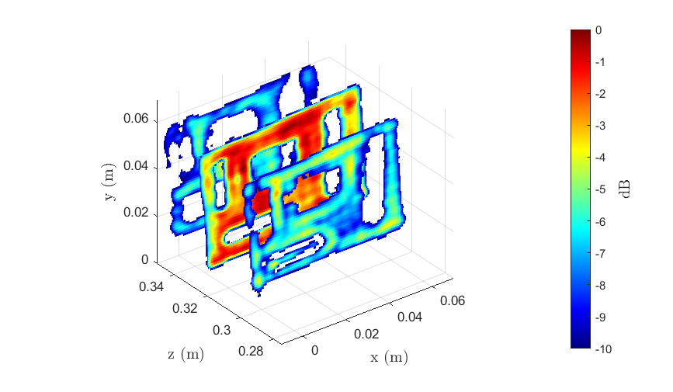
Real Results
Multi-Planar Array – Cutout
Antenna perturbance: Emulated Freehand
2-D BPA – 3 hrs
3-D BPA – 150 hrs
Ours – 1 s
RMA – 1 s
Ours – 14 s

Slide 13
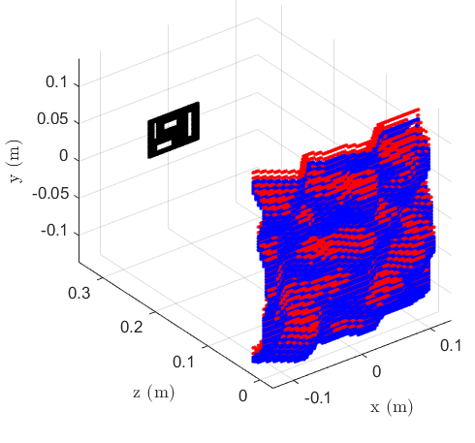
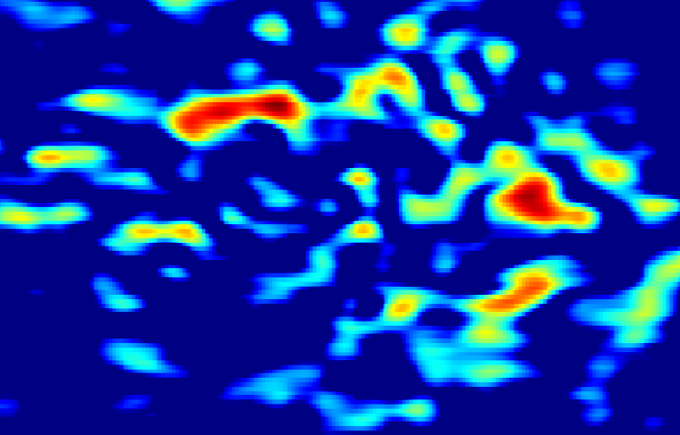
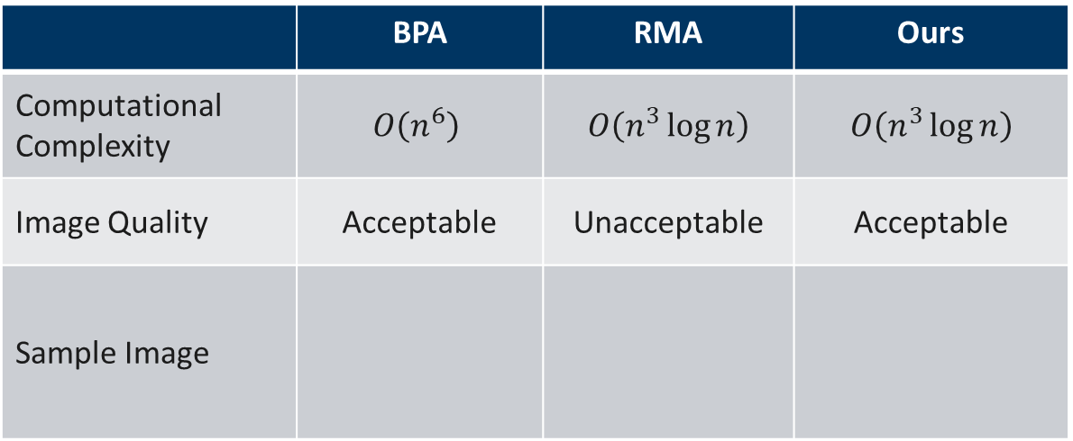
Conclusions and Summary
Enables non-cooperative image computation on mobile devices, cell phones, IOT applications
Same computational complexity as RMA with comparable image quality to BPA
 | BPA | RMA | Ours
Computational Complexity | $$O\left(n^{6}\right)$$ | $$O\left(n^{3}\log{n}\right)$$ | $$O\left(n^{3}\log{n}\right)$$
Image Quality | Acceptable | Unacceptable | Acceptable
Sample Image

